Slide 1
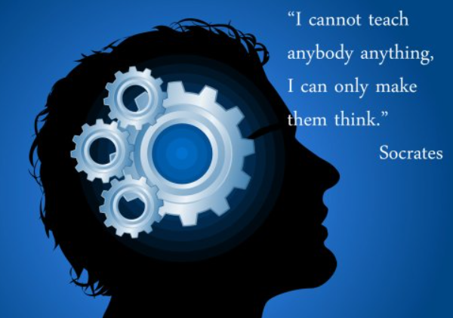
Lecture 1 Introduction Critical Thinking

Slide 2
What is Critical Thinking Critical thinking is that mode of thinking - about any subject, content, or problem - in which the thinker improves the quality of his or her thinking by skilfully taking charge of the structures inherent in thinking and imposing intellectual standards upon them.

Slide 3
Why is critical thinking important in the workplace?
A World Economic Forum report revealed that critical thinking is one of the most in-demand career skills employers seek when trying to attract and retain the best employees – and employers believe critical thinking skills will become even more necessary in the coming years.
Critical thinking in the workplace guarantees objective and efficient problem-solving, ultimately reducing costly errors and ensuring that your organization’s resources are used wisely. Team members employing critical thinking can connect ideas, spot errors and inconsistencies, and make the best decisions most often.

Slide 4
Process of Critical Thinking
Critical thinking is not as easy as a one-step action. It requires some detailed analysis and research. Critical thinking deals with solving problems through rational processes and evidence-based knowledge. Like any scientific method, critical thinking involves a lot of steps. But such steps help to save a lot of time in the long run when errors are avoided using such steps.

Slide 5
Steps in Critical thinking
Critical thinking includes four major steps namely evaluation, assessment, categorization, and reasoning.
Step 1 – Evaluation
This includes using logic to understand a problem in detail before coming up with a solution for the same.
Step 2 – Assessment
This includes considering the possible outcomes before taking any decision.
Step 3 – Categorization
This includes putting different solutions together based on their similarity before selecting any one of them.
Step 4 – Reasoning
This includes using logic to make decisions rather than being creative.

Slide 6
What are critical thinking skills?
Critical thinking is a soft skill that comprises multiple interpersonal and analytical abilities and attributes. Here are some essential critical thinking skills that can support workforce success.
Observation: Employees with critical thinking can easily sense and identify an existing problem – and even predict potential issues – based on their experience and sharp perception. They’re willing to embrace multiple points of view and look at the big picture.
Analytical thinking: Analytical thinkers collect data from multiple sources, reject bias, and ask thoughtful questions. When approaching a problem, they gather and double-check facts, assess independent research, and sift through information to determine what’s accurate and what can help resolve the problem.
Open-mindedness: Employees who demonstrate critical thinking are open-minded – not afraid to consider opinions and information that differ from their beliefs and assumptions. They listen to colleagues; they can let go of personal biases and recognize that a problem’s solution can come from unexpected sources.
Problem-solving attitude: Critical thinkers possess a positive attitude toward problem-solving and look for optimal solutions to issues they’ve identified and analyzed. They are usually proactive and willing to offer suggestions based on all the information they receive.
Communication: When managers make a decision, they must share it with the rest of the team and other stakeholders. Critical thinkers demonstrate excellent communication skills and can provide supporting arguments and evidence that substantiate the decision to ensure the entire team is on the same page.

